Slide 1


Heading To College
Roads were made for journeys not destinations

Slide 2


Slide Title 1
Type questions in the chat!
Agenda/Road Map
Where we are
Kahoot
Who is on your list
Applying to college
Senior Timeline
F.A.S.T
SAT/ACT
What are colleges looking for
Applications 101

Slide 3


Slide title 3
Making your college list with the following types of schools:
Safety
Match
Reach
CollegeGreenlight.com
BigFuture.com
Naviance
https://tinyurl.com/LamarVirtualTour
How do I know if I am applying to a Safety, Match, or Reach school?

Slide 4




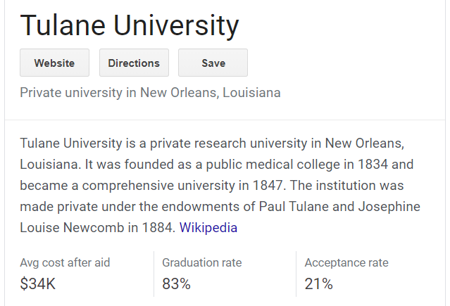
School Options
2-year & 4-year options
Public vs. Private
Cost of Attendance & Out of State Fees
Selective schools

Slide 5

Slide title 4
xoxo
How long do they take?
Websites to use for applications:
Apply Texas
Common App
Black Common App
Directly on the college’s website

Slide 6

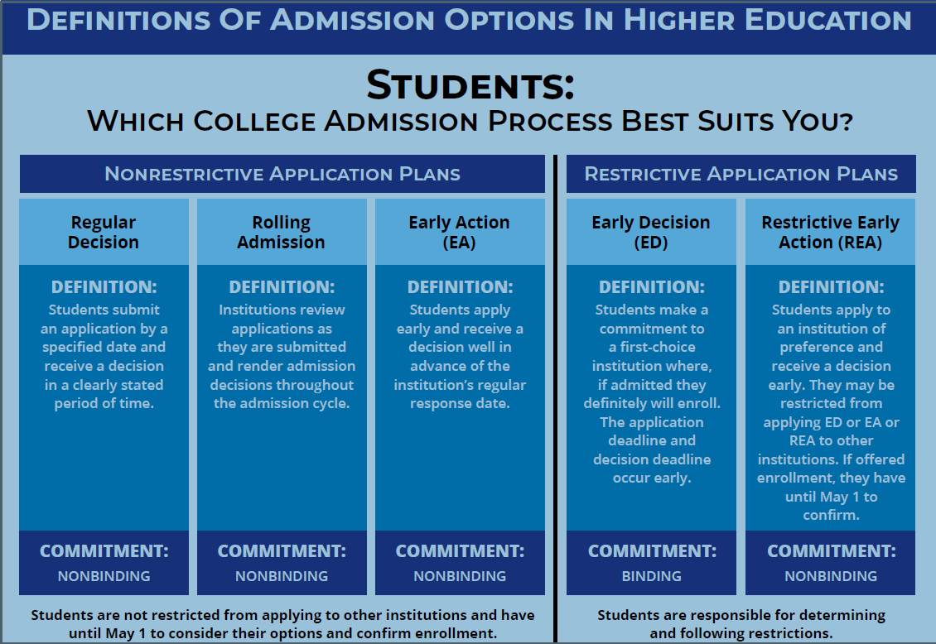

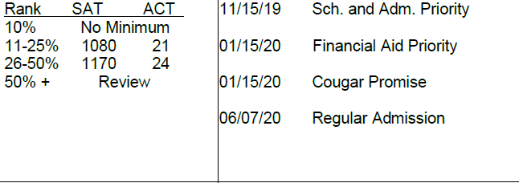
Types of Applications
Dates To Remember
October 15th – EA
November 1st – EA & ED
December 1st – Regular Decision In-State
January 1st – Regular Decision Out of State

Slide 7

Senior Timeline First Semester
Test Prep – ACT/SAT
College List
Essay & Resume Draft
Fill out RLS
Letters of Recommendation
Financial Aid
Applications Started
Essays & Resumes Finalized
Scholarship Applications
APPLICATIONS SUBMITTED BEFORE BREAK!

Slide 8

Slide title 7
Why should I take the SAT/ACT
Let’s do these applications!
F.A.S.T
F – Fee or Fee Waiver
A – Application
S – Scores – SAT/ACT (test optional schools not needed *)
T - Transcripts – Request on Naviance

Slide 9

WHY!
Khan Academy SAT Prep
A free, personalized practice program for the SAT through an exclusive partnership between Khan Academy and the College Board
Linking your accounts will further personalize your practice as item-level data from your SAT scores will be used by Khan Academy to generate specific practice recommendations based on an actual exam taken under test-like conditions.
https://forms.gle/M3ZExq4VutvP8EcV7 - Fill out this Google Form if you need an SAT Fee Waiver

Slide 10
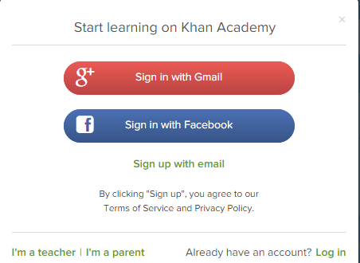

Slide title 5
1.
WHY!
Create a Khan Academy account
Go to satpractice.org
Click green button labeled “Check it out now”
Sign in with Gmail, Facebook, or click “Sign up with email”
If you click Sign in with Gmail or Facebook, enter in your username and password for either these accounts and you are signed in
Step 1: Log in or create a Khan Academy Account using your email at satpractice.org
Step 2: When prompted; agree to link your Khan Academy and College Board account.
Step 3: Sign in to your College Board Account. Do not create a duplicate.
Step 4: When prompted; hit “Send” to authorize the account linking
Step 5: Start practicing on Official SAT practice on Khan Academy!
2.
An email will been sent to your account to verify; sign in to your email
Open email from Khan Academy accounts and click on the “Finish Signing Up” button
A welcome screen will appear where you will enter username and password and click “Sign Up”

Slide 11

Rank the following based on how much weight you think each application component has in the selective college admissions process (1=Most Weight; 8=Least Weight)
Demonstrated Interest ___
Extracurricular Activities ___
Class Rank ___
Course Rigor ___
Test Scores ___
Letters of Recommendation ___
Grades ___
Personal Statement ___

Slide 12




Grades (1)
Course rigor (2)
Test scores (3, except at test optional schools)
Activities List (extracurriculars) (4)
Personal statement (5)
Letters of recommendation (6)
Demonstrated interest (7)
*Class rank (8, for private + out of state colleges)
Consistently High-Performing
Upward Trend
Erratic or Abnormal Dip
(Needs Explaining)
Downward Trend

Slide 13
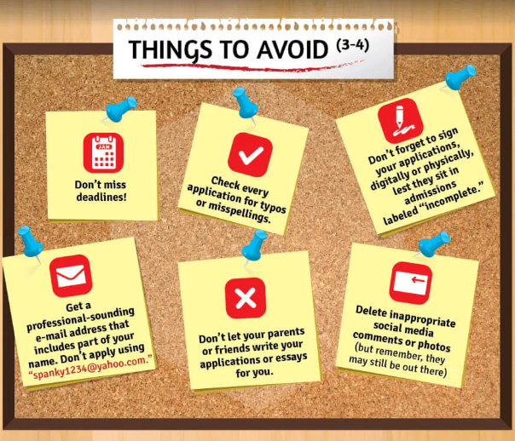

Slide title 4

Slide 14






Slide title 8
LHSCollegeCorner@gmail.com
Join College Corner Club!
One step at a time will get you to where you want to be

Slide 15

Slide title 6
Next Three Steps
1. Create a college list and visit the schools virtually.
2-3 Reach Schools
2-3 Mach Schools
2-3 Safety Schools
What questions do you have?
2. Create a Khan Academy account.
3. Create accounts on the application system you want to use.

